Slide 1
NETWORK TOPOLOGY DESIGN AT 27,000 KM/HOUR Debopam Bhattacherjee, Ankit Singla. Department of Computer Science, ETH Zürich
PRESENTER: OGHENEVOVWE A. IKUMARIEGBE

Slide 2
LEO NETWORKS
This paper was aimed at exploring network topology design for LEO constellation networks.
Key observation: Increasing the capacity of the inter-satellite network would increase throughput between end-to-end ground stations.

Slide 3
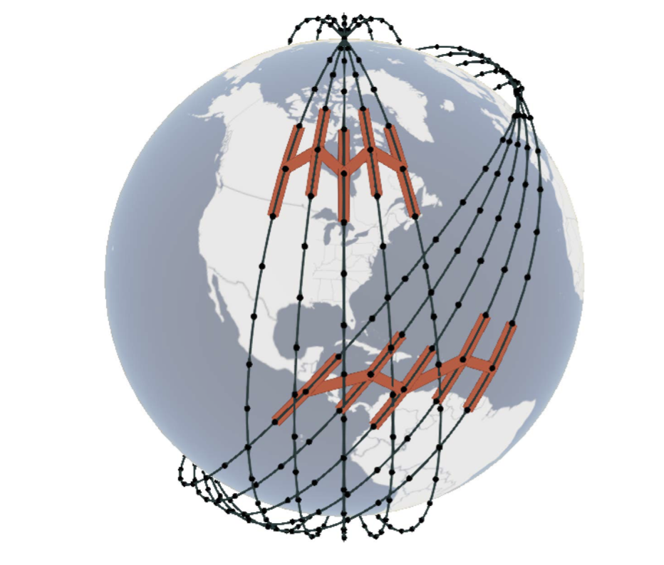
MAINSTREAM IDEA: GRID-LIKE STRUCTURE
A topology design consisting of links to neighboring satellites in the four directions (a grid-like) structure, +Grid.
However, such design is limiting and underutilizes the network since an ISL has a farther reach than the neighboring satellite.

Slide 4
AN EXAMPLE OF A LEO SATELLITE NETWORK
Kuiper
 | Phase A | Phase B | Phase C
Orbital Planes | 34 | 36 | 28
Satellite per plane | 34 | 35 | 28
Altitude (km) | 630 | 610 | 590
Inclination | 51.9 | 42 | 33

Slide 5
KEY POINTS ABOUT A LEO SATELLITE NETWORK
Satellites move very fast.
ISLs are needed because using just GS up-and-down links would incur high overhead and latency.
ISLs are constrained mainly by visibility and power.
Less hops implies that less satellites are used to carry a particular traffic.

Slide 6
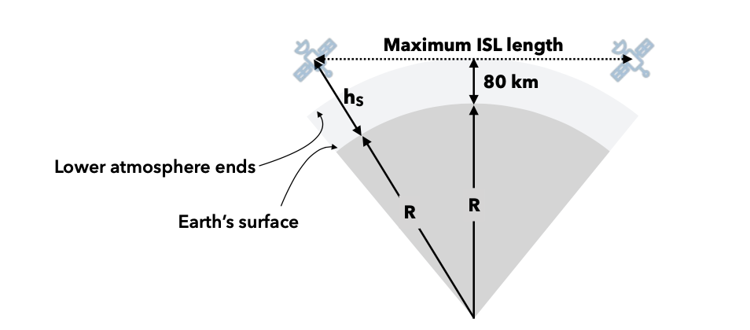
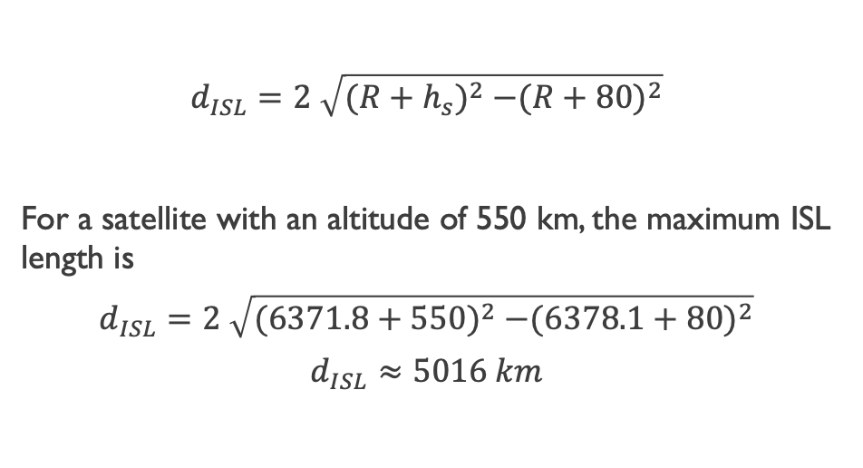
VISIBILITY
$$d_{ISL}=2 \sqrt{{(R+h_{s})}^{2} −{(R+80)}^{2}}$$
For a satellite with an altitude of 550 km, the maximum ISL length is
$$d_{ISL}=2 \sqrt{{(6371.8+550)}^{2} −{(6378.1+80)}^{2}}$$
$$d_{ISL}≈5016 km$$

Slide 7
Investigating traditional network design approaches
The network design approaches for terrestrial networks were evaluated for a dynamic, satellite network.
Integer linear programming
Random regular graphs
Ant-colony optimization

Slide 8
OPTIMIZATION PROBLEM
Inputs
Satellites trajectories.
Number of inter-satellite connection units
Target traffic matrix between terrestrial end points
Goal: A network design that minimizes latency and hop-count in end-end paths.

Slide 9
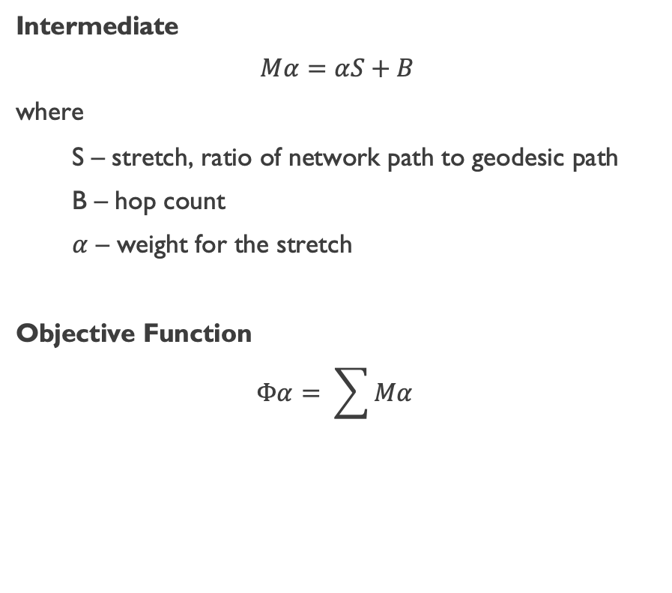
Integer LINEAR PROGRAMMING
Inputs
L : Maximum number of ISLs allowed per satellite.
v_{ab} : Is sat_{a} visible to sat_{b} and within its range?
d_{ab} : Linear distance between satellite sat_{a} and sat_{b}.
A traffic matrix, H , between terrestrial sites.
Outputs
y_{ab}
x^{st}_{ab}
Intermediate
$$Mα=αS+B$$
where
S – stretch, ratio of network path to geodesic path
B – hop count
$α$ – weight for the stretch
Objective Function
$$Φα= \sum{Mα}$$

Slide 10
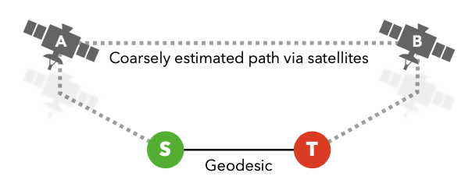
Satellite path vs geodesic distance
Customized ILP: Satellites “too far away” from the geodic between endpoints shouldn’t carry traffic.

Slide 11
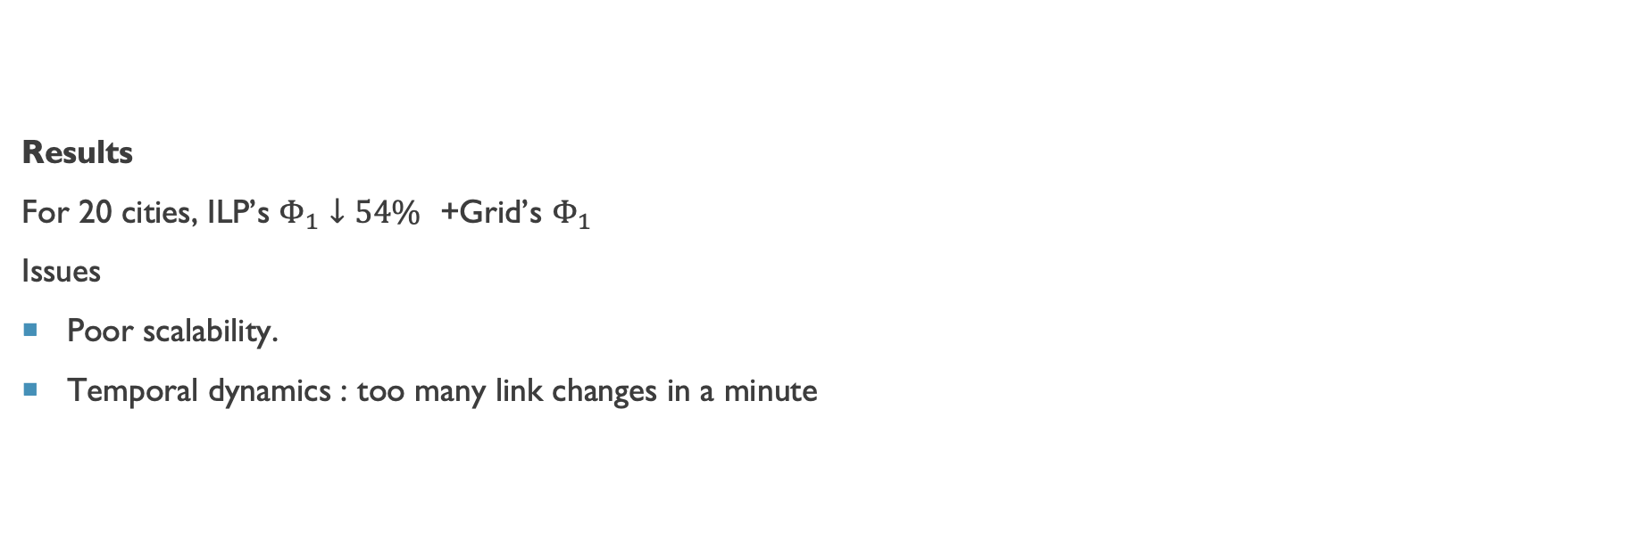
Results and issues
Results
For 20 cities, ILP’s $Φ_{1}↓54\%$ +Grid’s $Φ_{1}$
Issues
Poor scalability.
Temporal dynamics : too many link changes in a minute

Slide 12
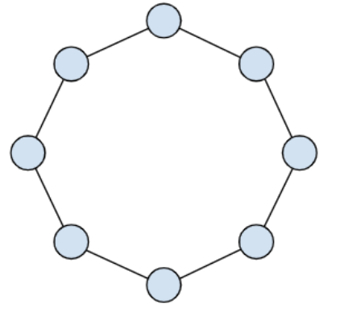
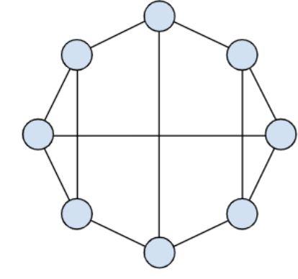
Random Regular Graphs (Customized)
Idea: Sampling permissible edges.
Constraint: Only satellites with fewer than 4 connections are added.

Slide 13
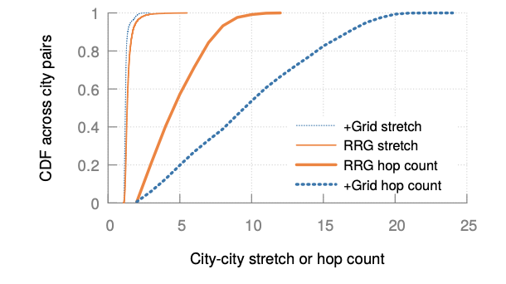
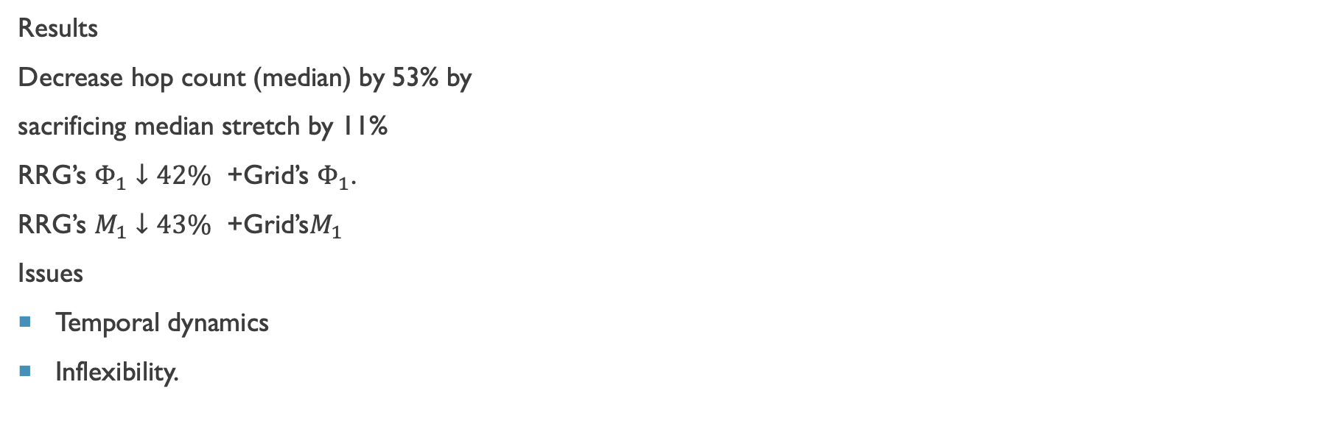
Results and issues
Results
Decrease hop count (median) by 53% by
sacrificing median stretch by 11%
RRG’s $Φ_{1}↓42\%$ +Grid’s $Φ_{1}$.
RRG’s $M_{1}↓43\%$ +Grid’s$M_{1}$
Issues
Temporal dynamics
Inflexibility.

Slide 14
ANT-COLONY OPTIMIZATION
Optimized from random graphs.
Conclusion.
Works well for small problem sizes, but doesn’t converge for big ones. It also causes huge link churn.

Slide 15
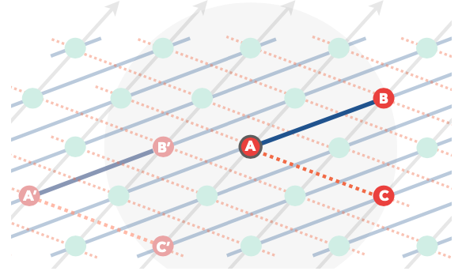
NOVEL APPROACH : MOTIFS
Motifs : repeated connectivity pattern (3-satellite, 2-links) across the constellation,. Can be considered as a generalization of +Grid

Slide 16
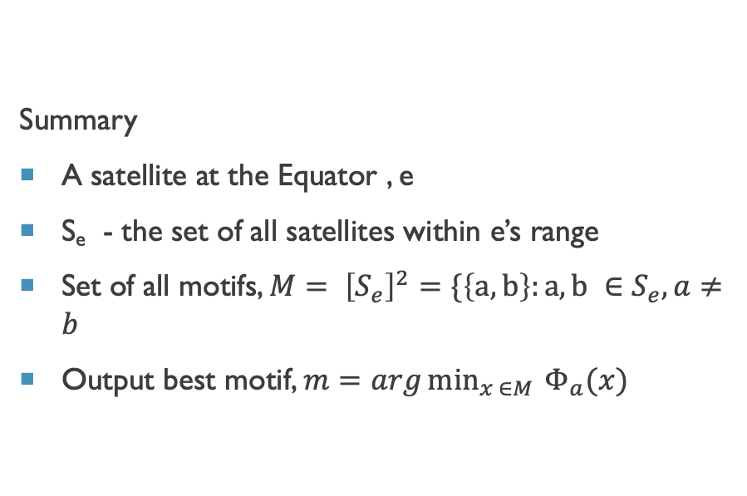
OBSERVATIONS AND APPROACH
APPROACH ONE:
Evaluating all possible motifs to select one with the best performance
Observation : There are fewer in-range satellites at the Equator. So, selecting motifs near the Equator ensures that links are kept throughout the constellation, that is, no link churn.
Summary
A satellite at the Equator , e
S_{e} - the set of all satellites within e’s range
Set of all motifs, $M= {\left[S_{e}\right]}^{2}=\{\left\{a,b\right\}:a,b ∈S_{e}, a≠b$
Output best motif, $m=arg\min_{x ∈M }{Φ_{a}(x)}$

Slide 17
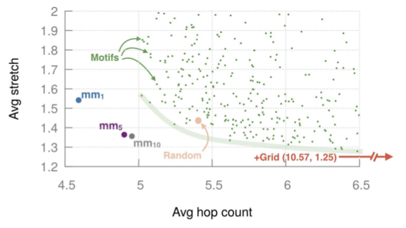
PERFORMANCE AT AN Arbitrary snapshot

Slide 18
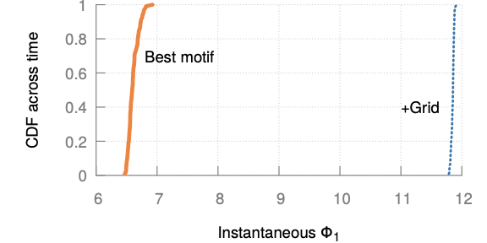
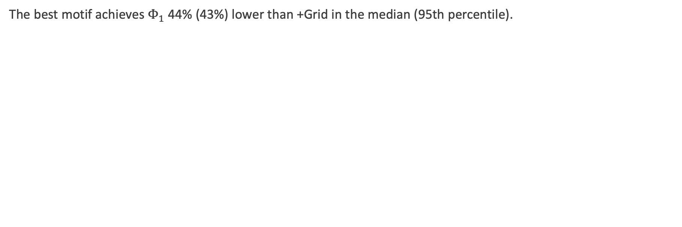
PERFORMANCE OVER TIME
The best motif achieves $Φ_{1}$ 44% (43%) lower than +Grid in the median (95th percentile).

Slide 19
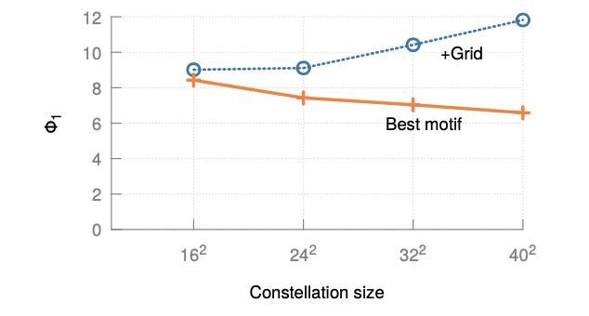
PERFORMANCE OVER DIFFERENT CONSTELLATION SIZES

Slide 20
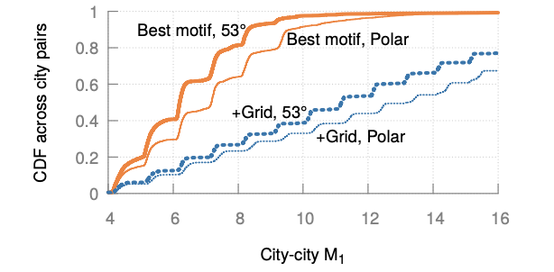
PERFORMANCE OVER DIFFERENT INCLINATIONS
The median improvement in M₁ going from +Grid to motifs is 46% for the polar constellation, compared to 44.5% for the 53° one

Slide 21
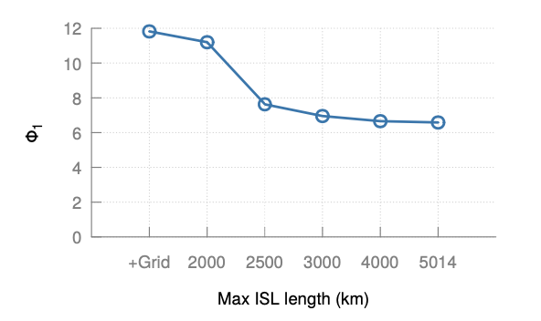
POWER LIMITATIONS – MAXIMUM ISL RANGE AT 3000 km

Slide 22
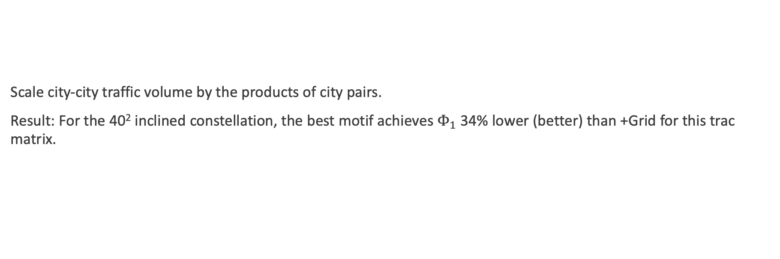
GDP TRAFFIC MATRIX
Scale city-city traffic volume by the products of city pairs.
Result: For the 40² inclined constellation, the best motif achieves $Φ_{1}$ 34% lower (better) than +Grid for this trac matrix.

Slide 23
APPROACH 2
Based on previous observation, different motifs can be computed for different latitudes.
Issues: Huge, impractical computation needed,

Slide 24
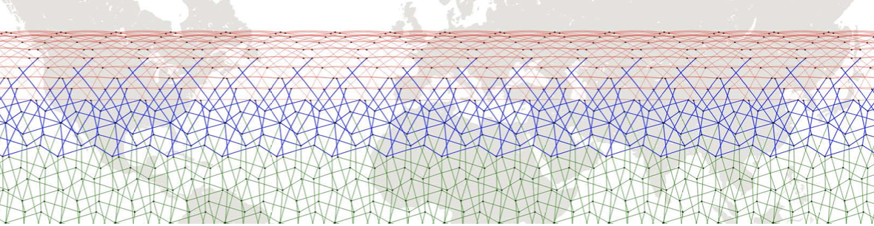
APPROACH 3
Different motifs computed for different latitudes zones.
For 53° constellation, a zone width of 18° results in 3 zones: 0-18°, 18-36°, 36-53°

Slide 25
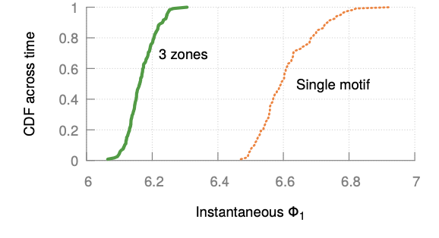
IMPROVEMENTS SATURATE AFTER THREE ZONES

Slide 26
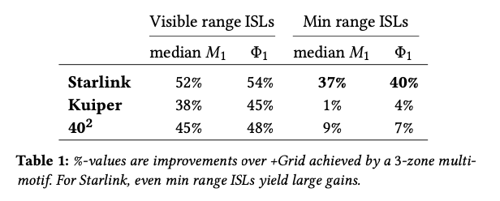
STARLINK AND KUIPER - optimizations

Slide 27
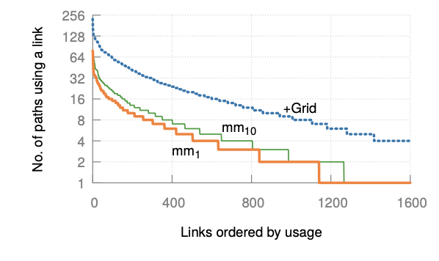

STRETCH AND HOP counts
$Φ_{1}$ , $Φ_{5}$ , $Φ_{10}$ improvements are respectively 48%, 30%, and 20% over +Grid

Slide 28
QUESTIONS
Why do they mention that longer ISLs ranges are needed when there’s a visibility constraint?
Answer: It was mentioned for the Telesat satellite constellation. It has a higher altitude and hence a longer ISL range.

Slide 29
THANK YOU!

